Slide 1
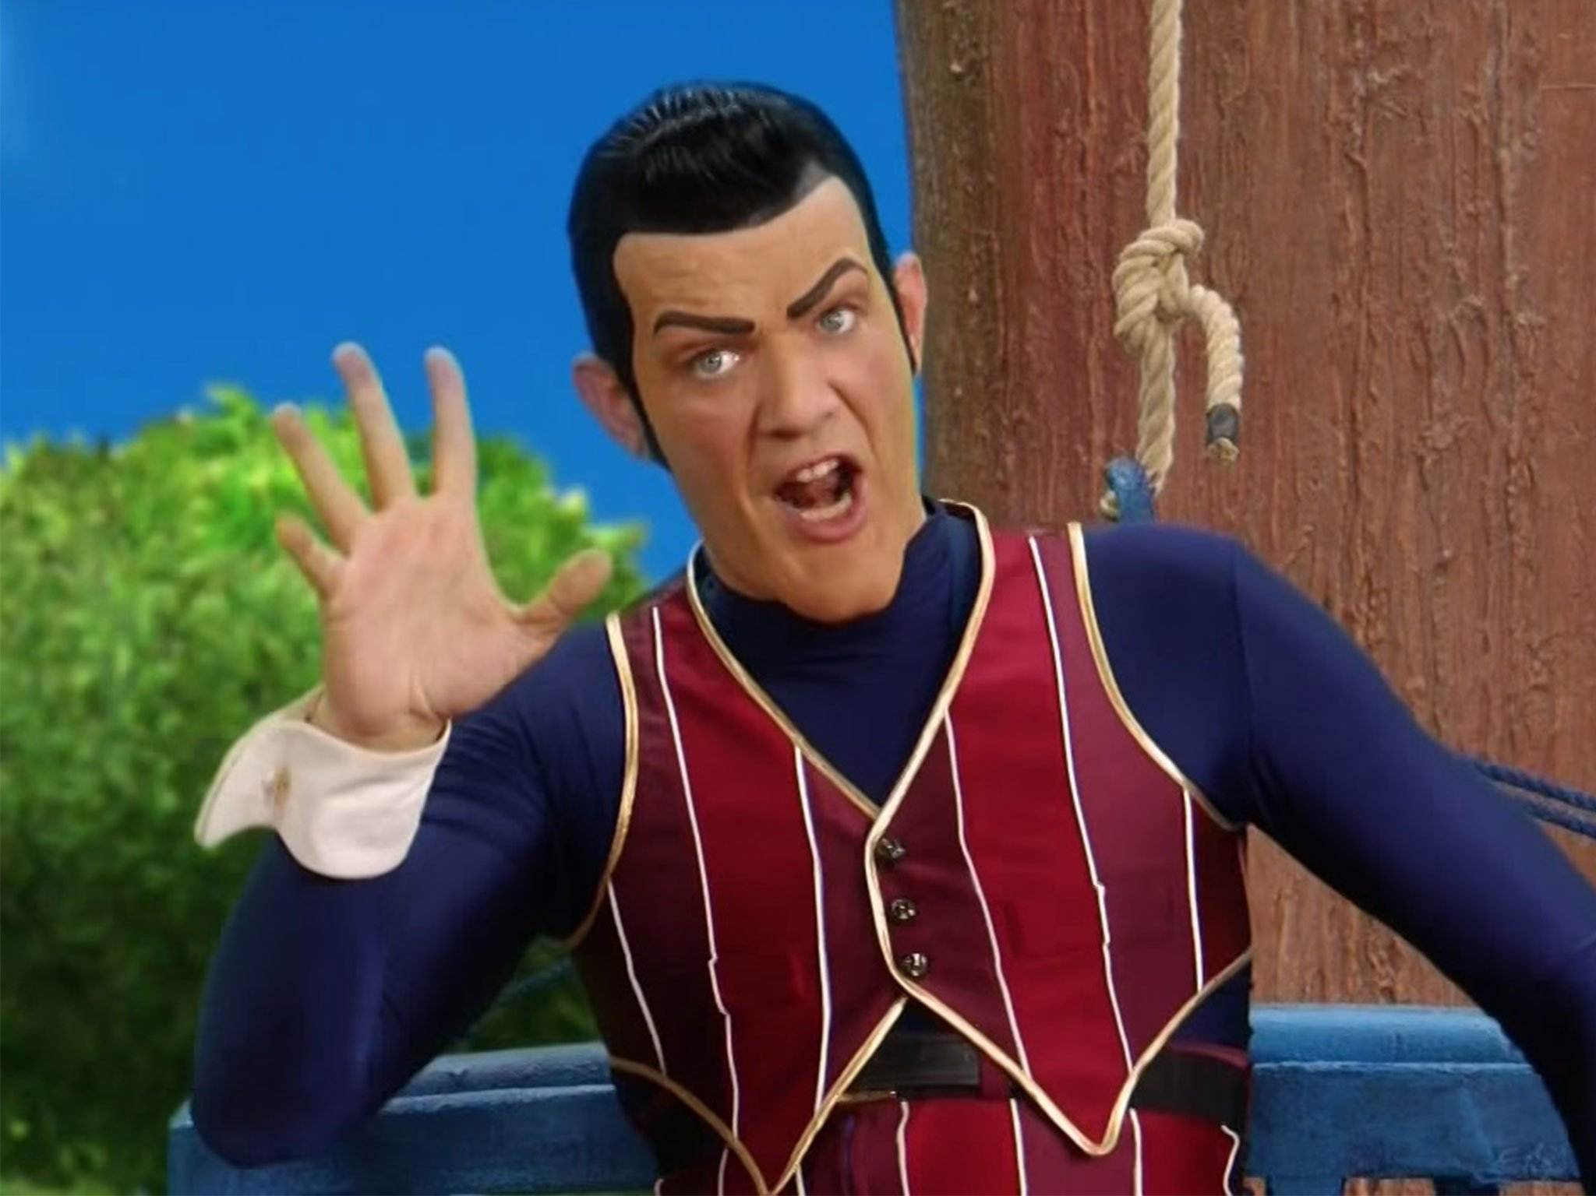
Number One
Final Approach
Notes:
Start

Slide 2

Glyn: Digital Programming Olivier: Hardware & Hardware Programming Rick: Website & Level Design Tamara: 2D Artist Humam: General Art & Sound Designer Rob: 3D Artist & Scrum Master
Notes:
Rick - Roles

Slide 3
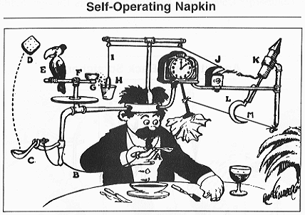
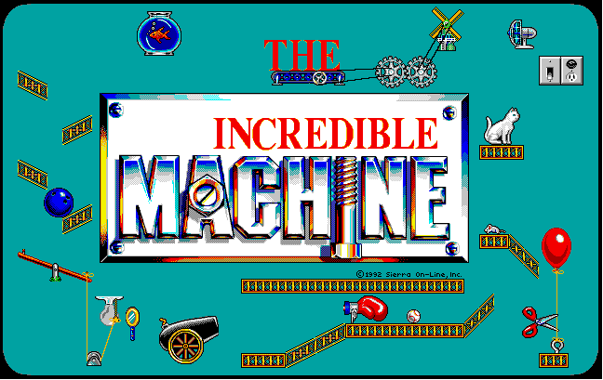
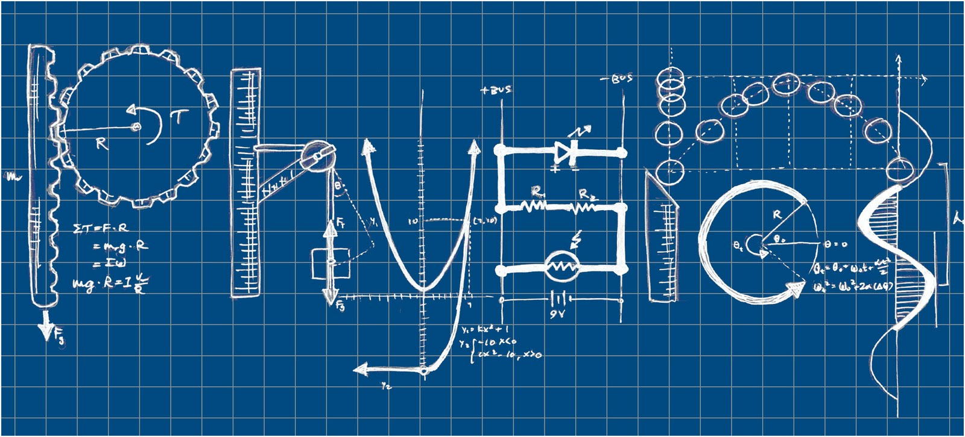
One-Pager
Research Question
Chain Reaction
Incredible Machine
Notes:
Rick – One Pager, what is a chain reaction? What is the incredible machine? What makes it either of those?

Slide 4
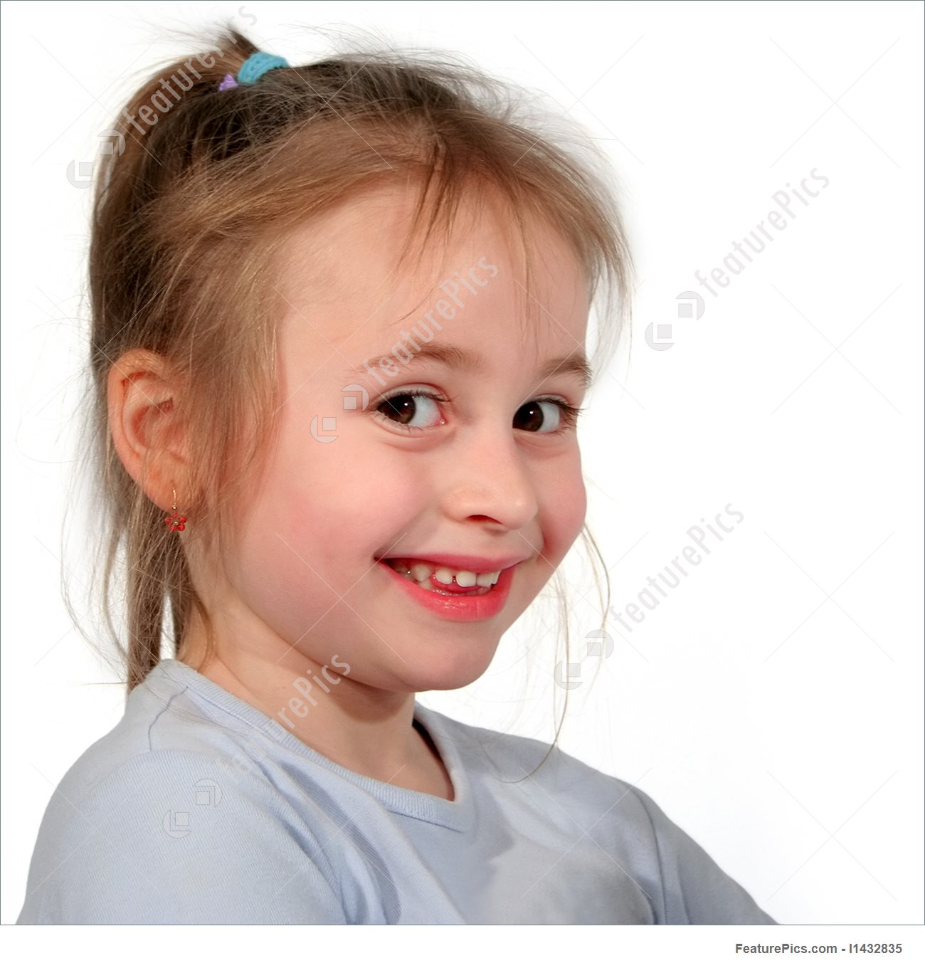

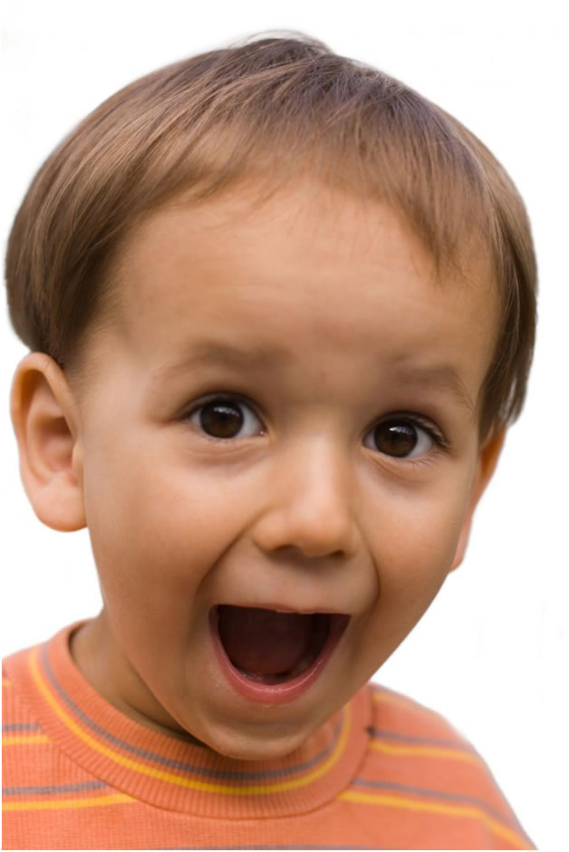
Value Proposition
Have fun while making a robot!
Inspiration for young engineers to be
Have children learn about physics
Notes:
Rick – Value Prop

Slide 5
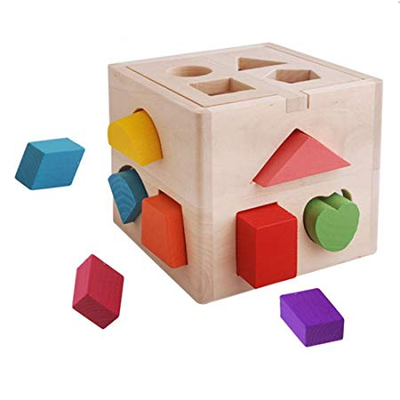
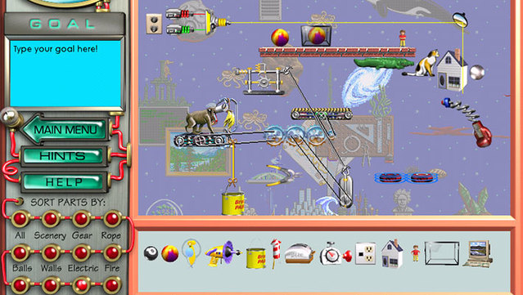
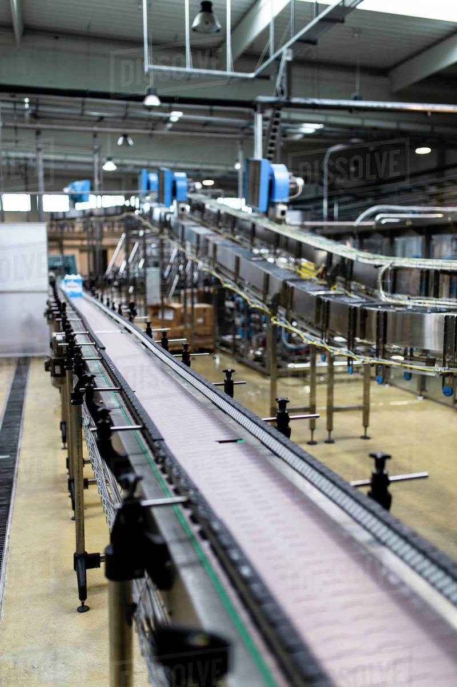
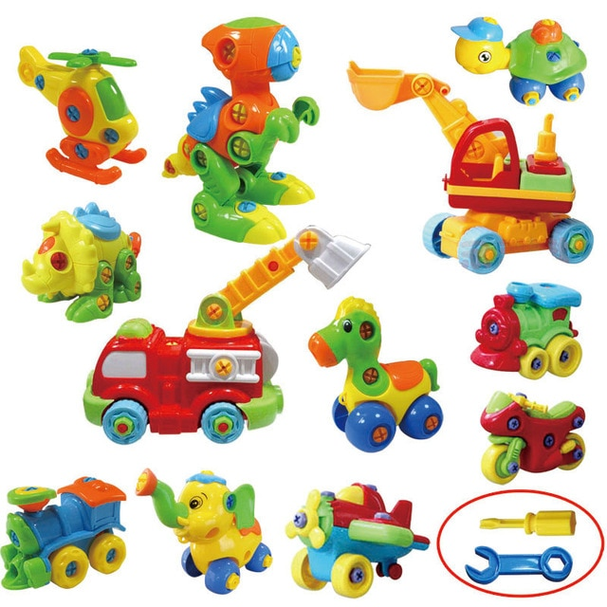
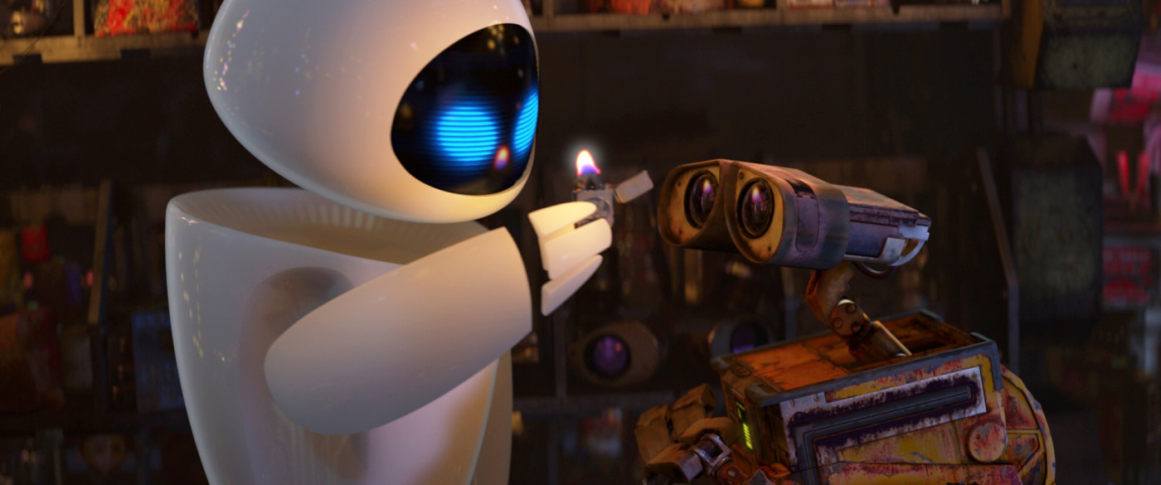
Notes:
Rick - Inspiration

Slide 6
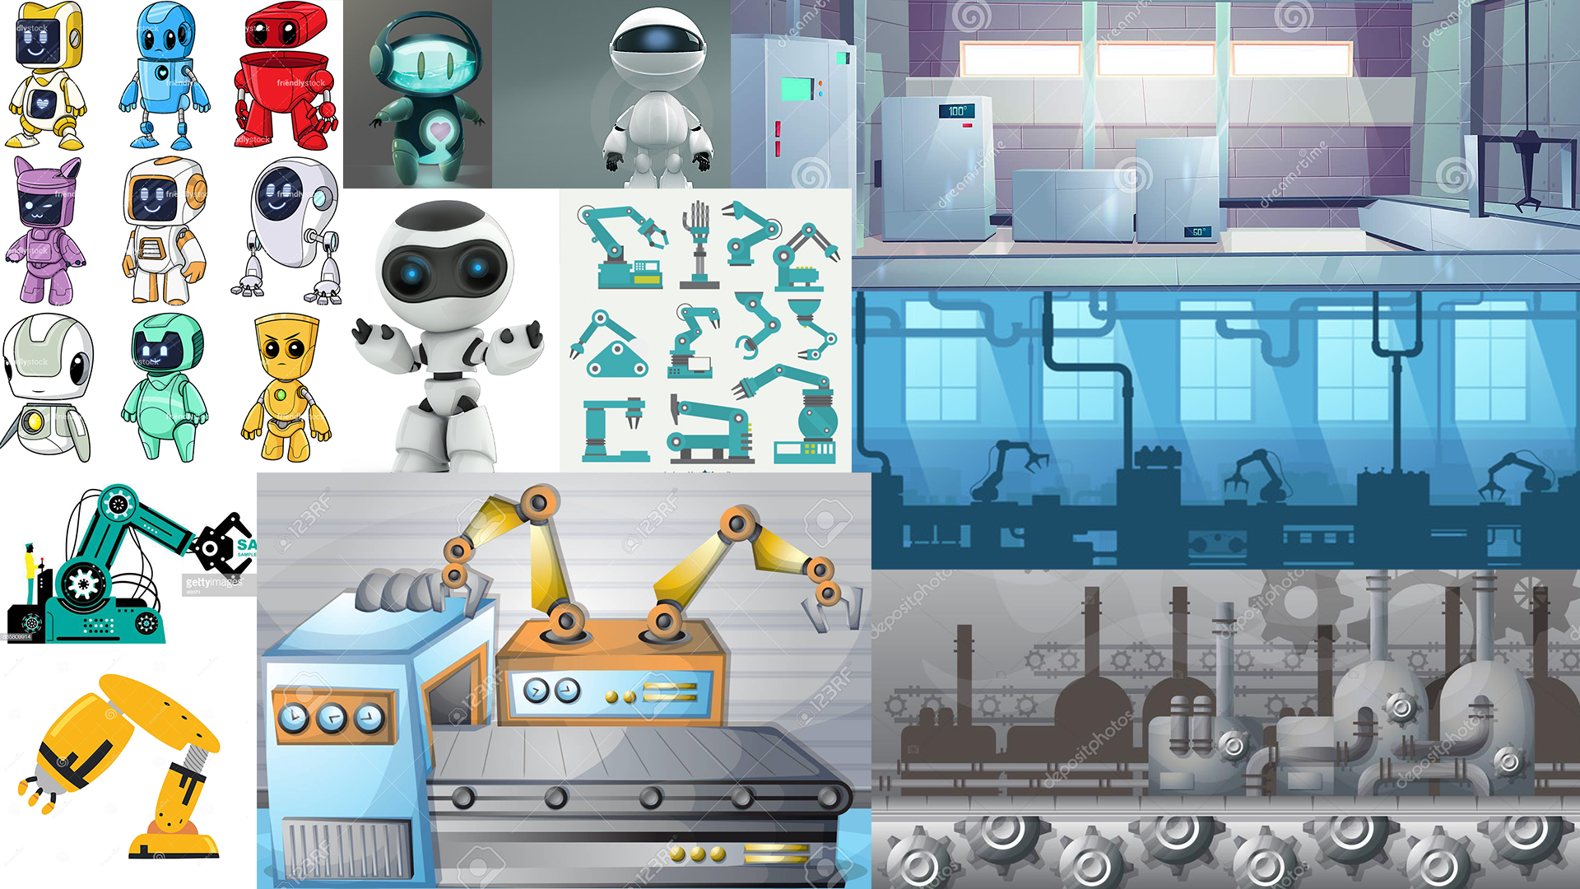
Notes:
Tamara – Game Moodboard

Slide 7
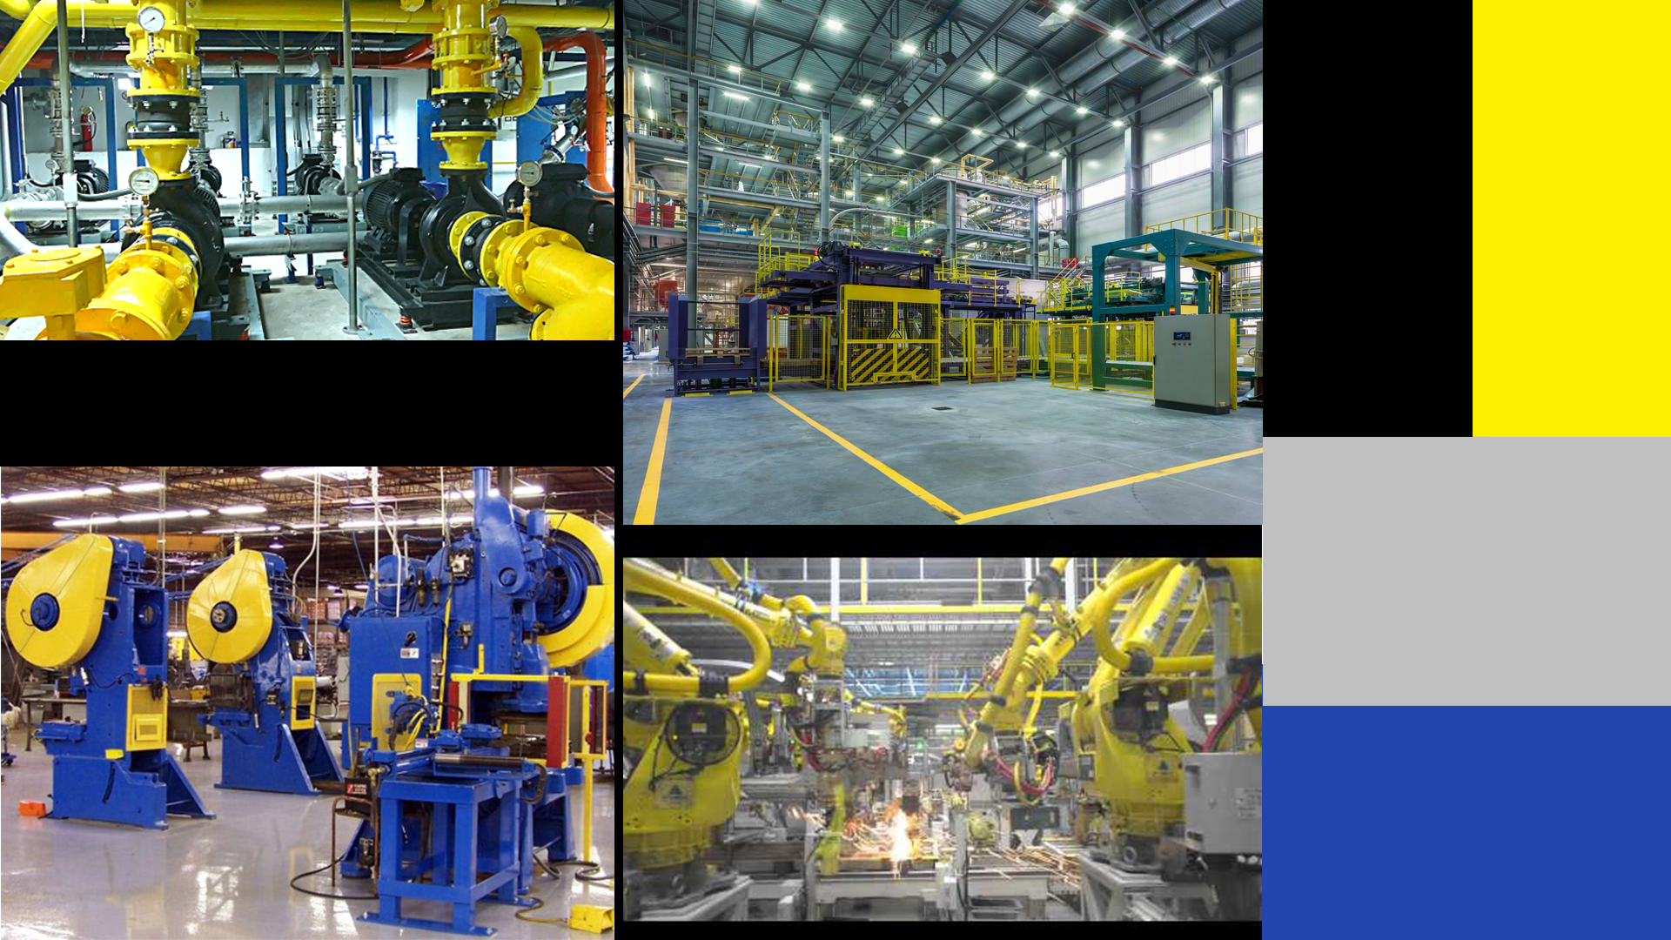
Notes:
Tamara – Chain Reaction Moodboard

Slide 8
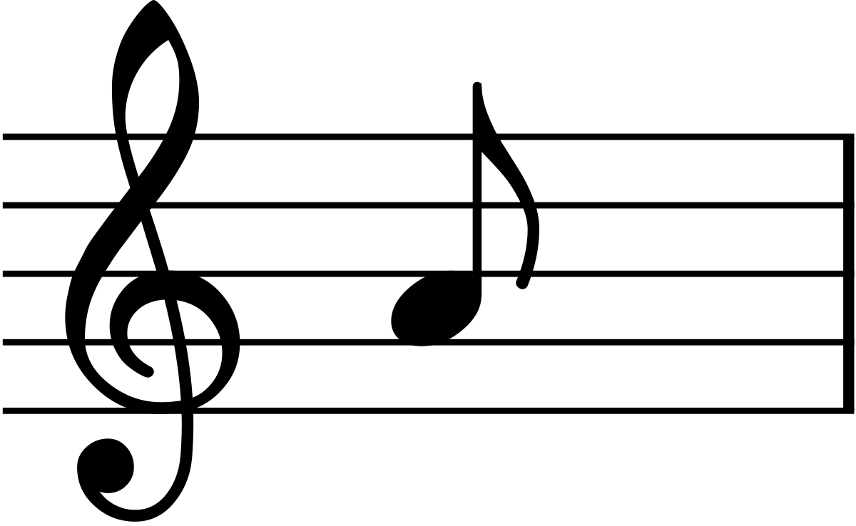

Notes:
Humam – Audio Moodboard It plays by clicking or pressing right arrow

Slide 9


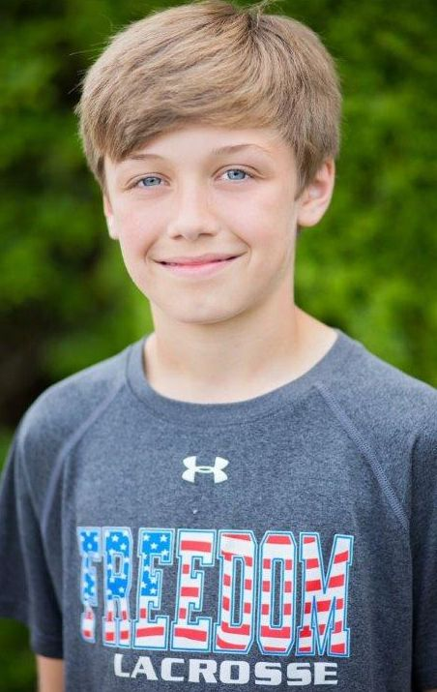
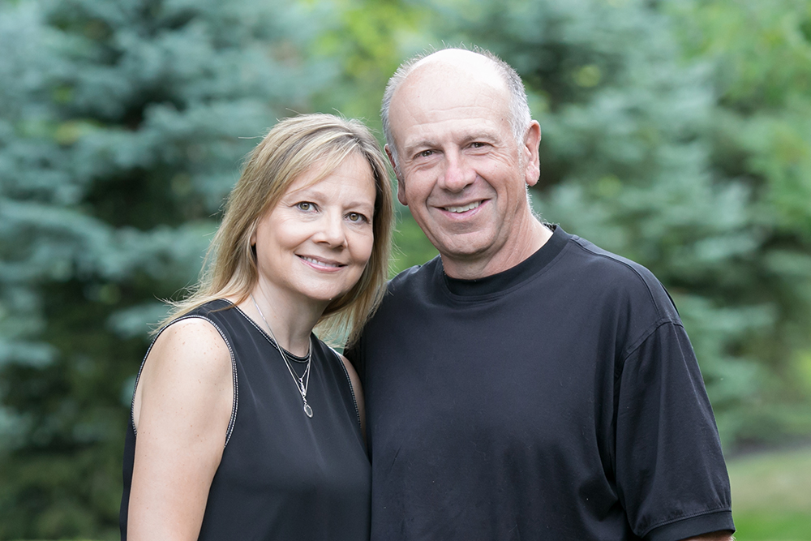
Concept Description
Target audience:
Children aged 4-12
Their parents
Notes:
Humam – Target audience

Slide 10
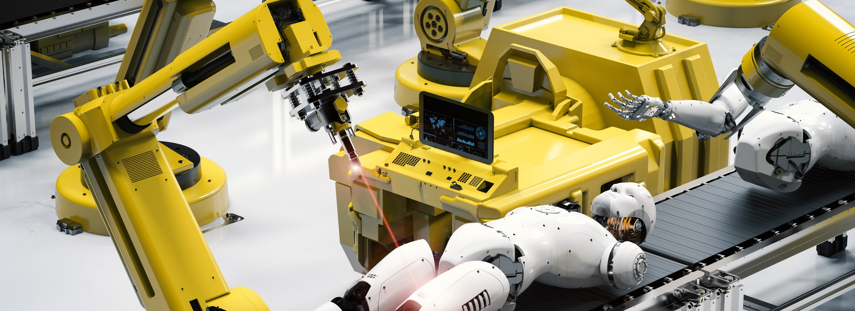
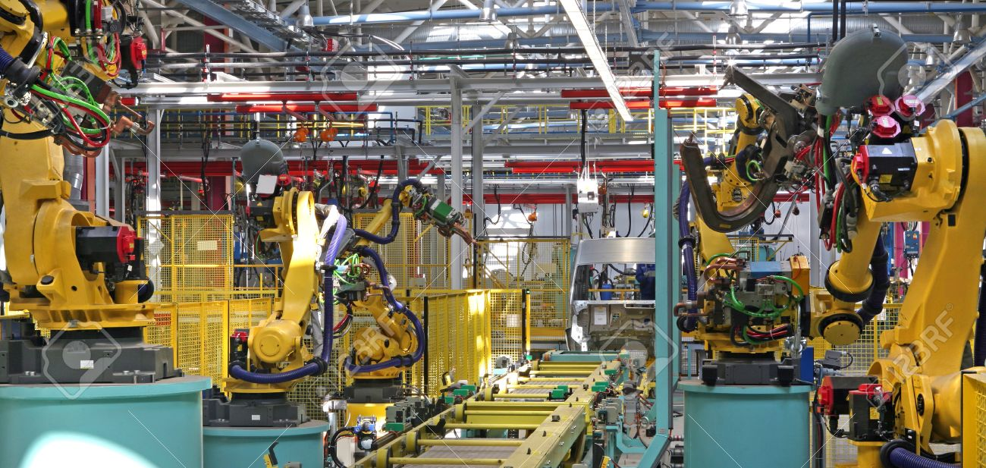
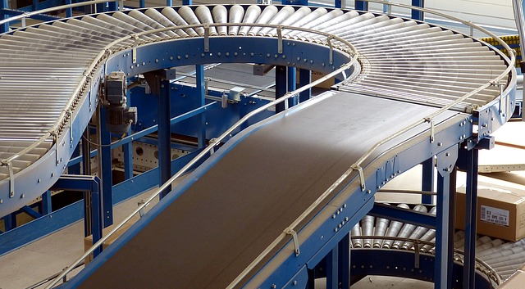
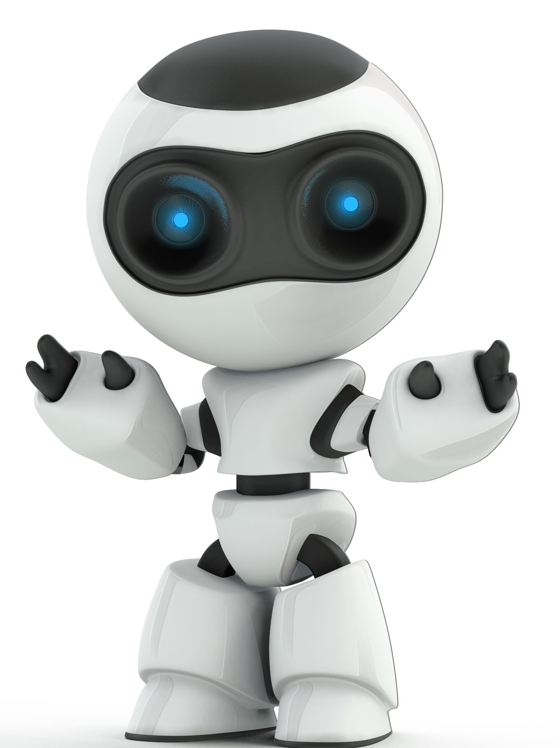
Concept description
Main goal: initiate a chain reaction to build a robot. Synopsis: In a factory, a conveyor belt is moving components of a machine. The process is showcasing a production line of robots. The robots are produced through combining different body parts. The robots are being assembled through different mechanisms that involves physics. It’s a representation of the birth of machines and how a robot comes to life. When the robot is fully assembled, the process is completed, and the robot is put in a box ready for shipment and for life as an android.
Notes:
Humam – Start with main goal then explain the Synopsis
In a factory, a conveyor belt is moving components of a machine. The process is showcasing a production line of robots. The robots are produced through combining different body parts. The robots are being assembled through different mechanisms that involves physics. It’s a representation of the birth of machines and how a robot comes to life. When the robot is fully assembled, the process is completed, and the robot is put in a box ready for shipment and for life as an android.

Slide 11
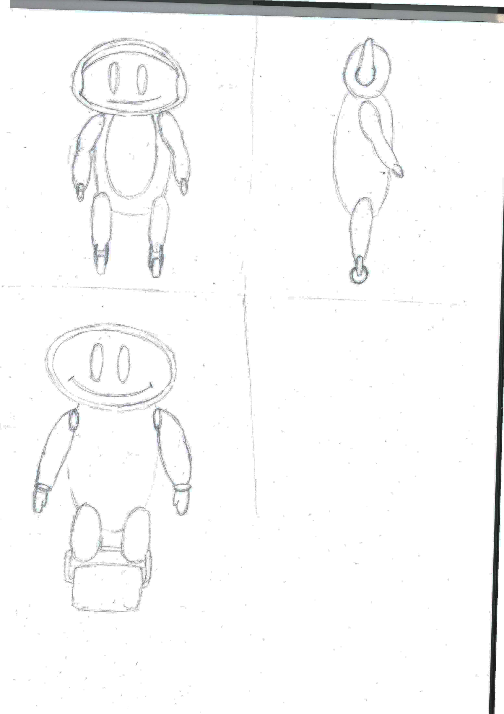
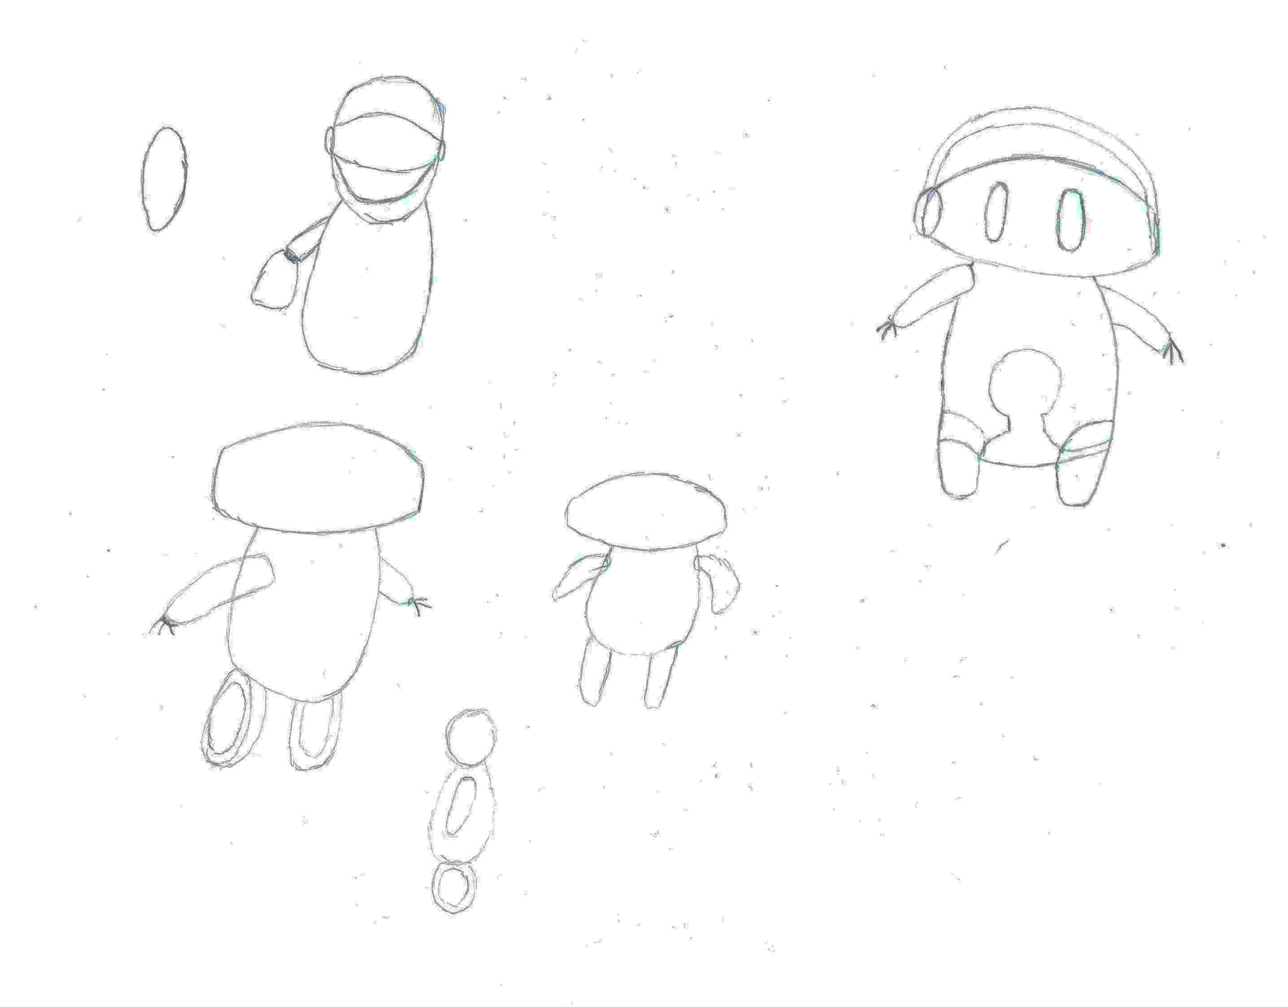
Sketches
Notes:
Humam – Character sketches Might be too vague? But can’t up that well

Slide 12
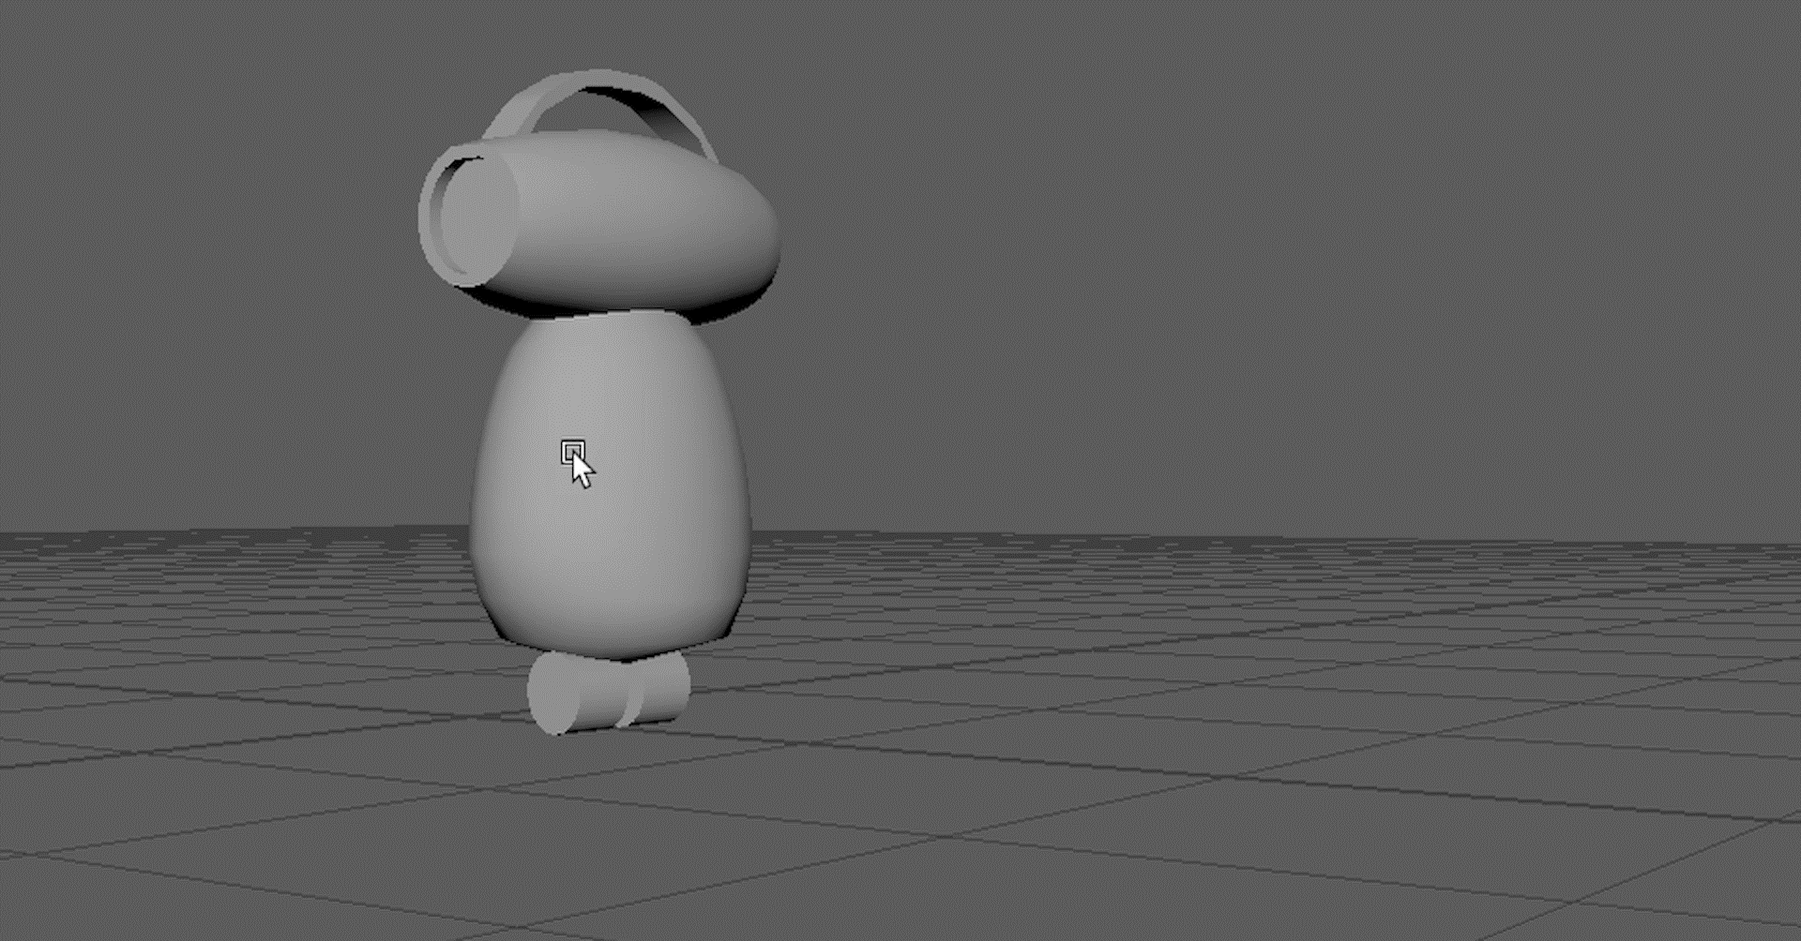
Notes:
Humam - Model

Slide 13
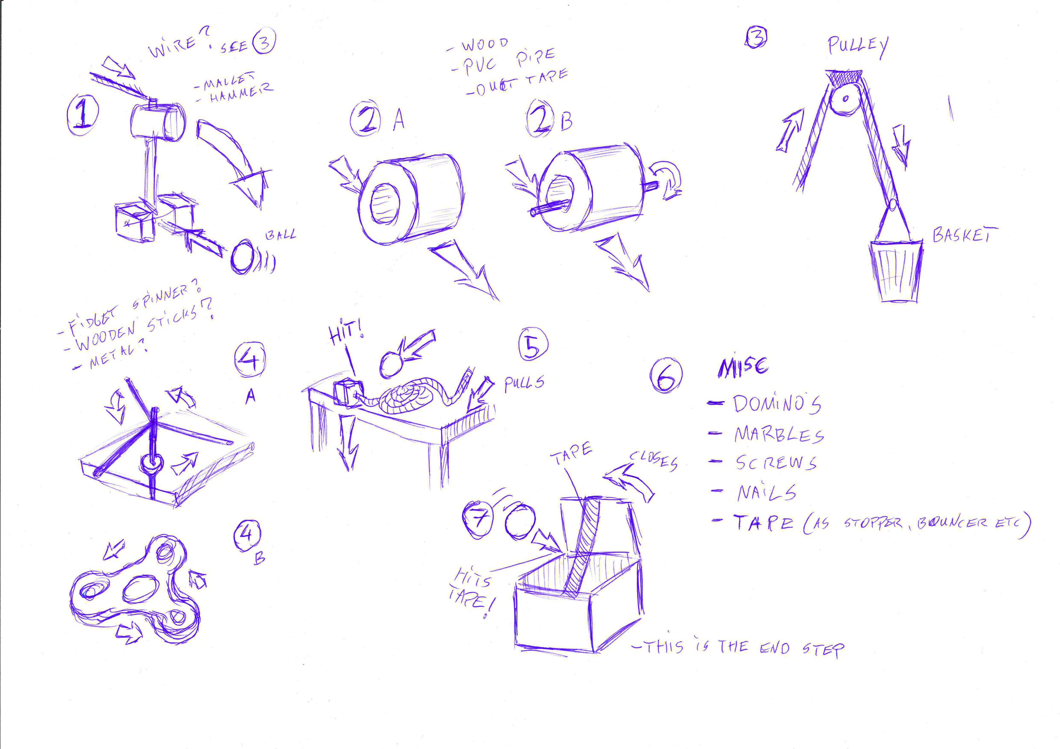
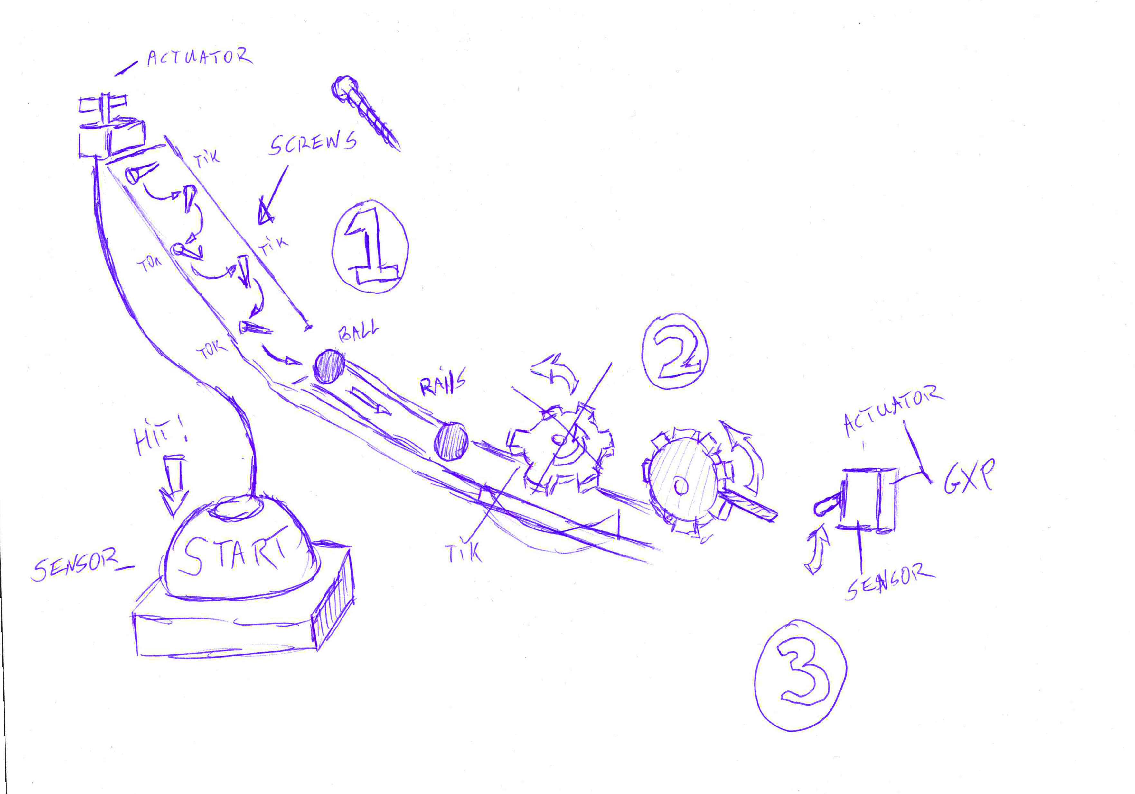
Chain Reaction
Notes:
Rick – Chain Reaction

Slide 14
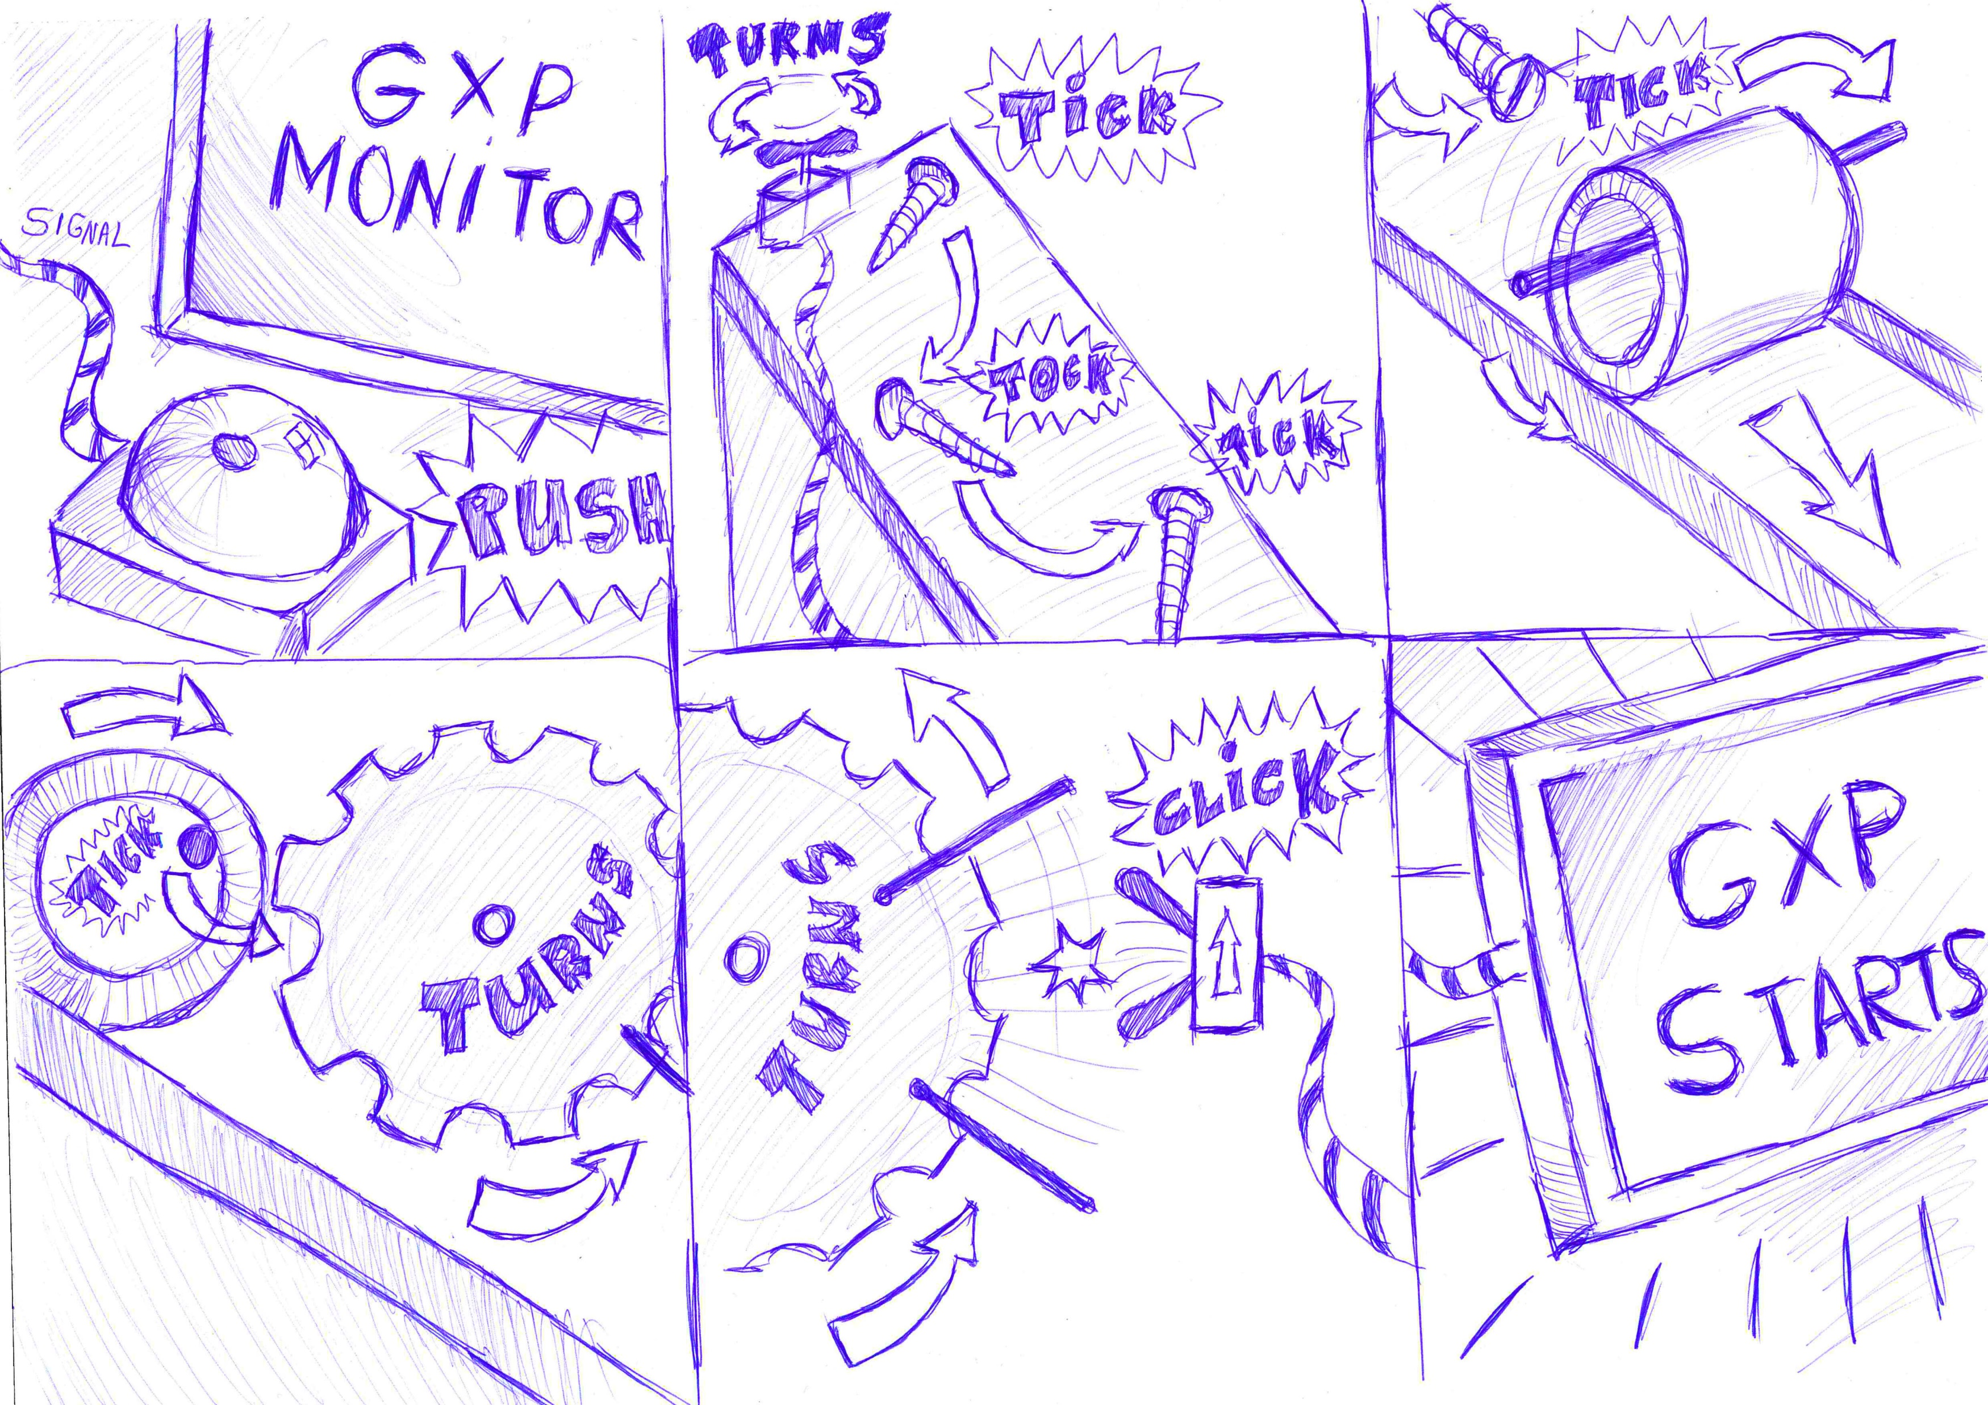
Notes:
Rick – Chain Reaction

Slide 15
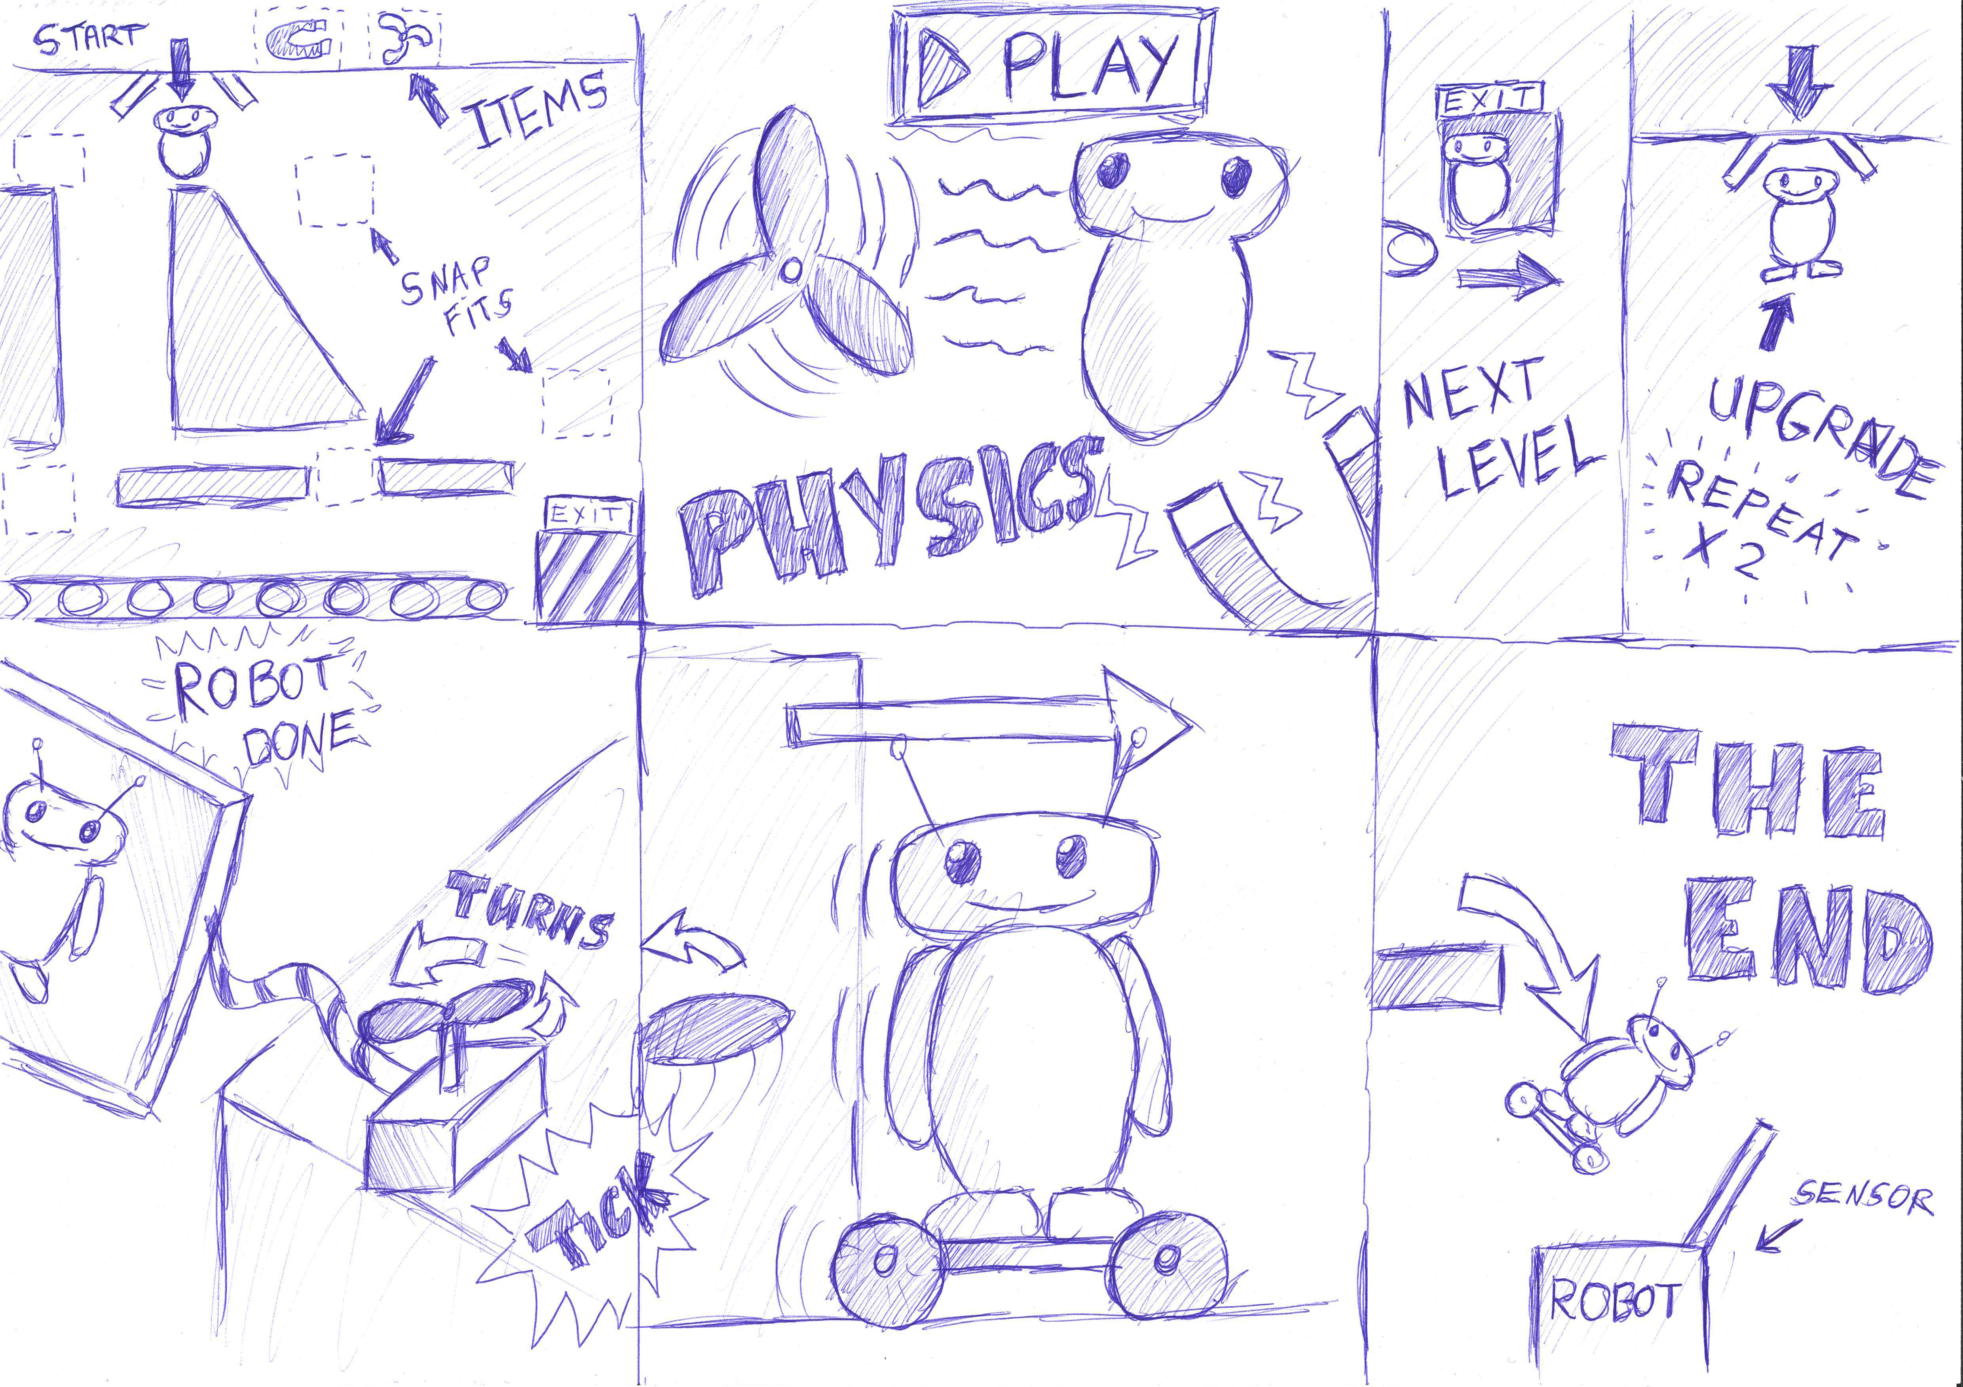
Notes:
Rick – Chain Reaction

Slide 16
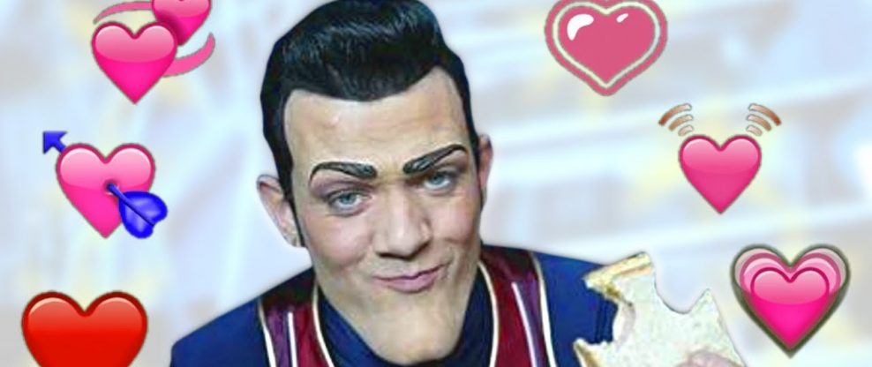
Thank you for listening

